Slide 1
Presentation Skills

Slide 2
Types of presentations
Providing Information
Reporting Progress/status
Teaching a skill
Selling product/Service/Idea (Persuasion)
Making a decision- Evaluation of options
Solving a problem

Slide 3
Stages of Presentation
Plan
Define objective
Write
Complete
Revise
Do research
Audience Analysis
Plan Intro- Body- Conclusion- Hook-Line-Sinker
Supporting Visuals and Speaking Notes
Prepare
Mechanics of speaking
Handling Questions
Anticipating questions

Slide 4
Planning- Define objective “Every presentation has a job to do”
What do you plan to achieve. Be as precise as possible
What do you want the receiver to do or believe
Examples:
To inform potential entrepreneurs about three important factors that loan officers consider before granting start-up loans to launch small businesses.
Address employee concern regarding the new health-care plan
Convince management why re-organizing technical support department will improve customer service

Slide 5
Eg: OBJECTIVES OF THE SPEAKER: To inform potential entrepreneurs about three important factors that loan officers consider before granting start-up loans to launch small businesses
Meeting target- business from atleast 60% of the participants
Introduce your firm/bank as the optimal option
Key impressions of the firm- MARKET LEADERS; ETHICAL; TRANSPARENT; COMPETITIVE; BIGGEST ALLIES OF THE CUSTOMERS

Slide 6
Eg:OBJECTIVES OF THE AUDIENCE: To know about important factors that loan officers consider before granting start-up loans to launch small businesses
GET LOANS AT THE CHEAPEST RATES AT OPTIMAL LENGTH POSSIBLE
LEARN TRICKS HOW TO INCREASE CREDIT
Introduce bank X as the optimal option
Key impressions of the firm- MARKET LEADERS; CUSTOMER-ORIENTED; ETHICAL; COMPETITIVE;

Slide 7
Planning- Audience Analysis
Profile the audience based on
Technical Knowledge
Level of education
Position in institutional hierarchy
Needs/Demands/Expectation/Concern (“What’s in it for me”)
Psychological profile
Attitude – Familiarity, interest, Hostility
Bias- political, social, religious
Values and belief
Motivation

Slide 8
Basic human psychology when confronted with ideas/information
Boring: Ignore it.
Dangerous: Fight or Flight.
Complicated: Radically summarize

Slide 9
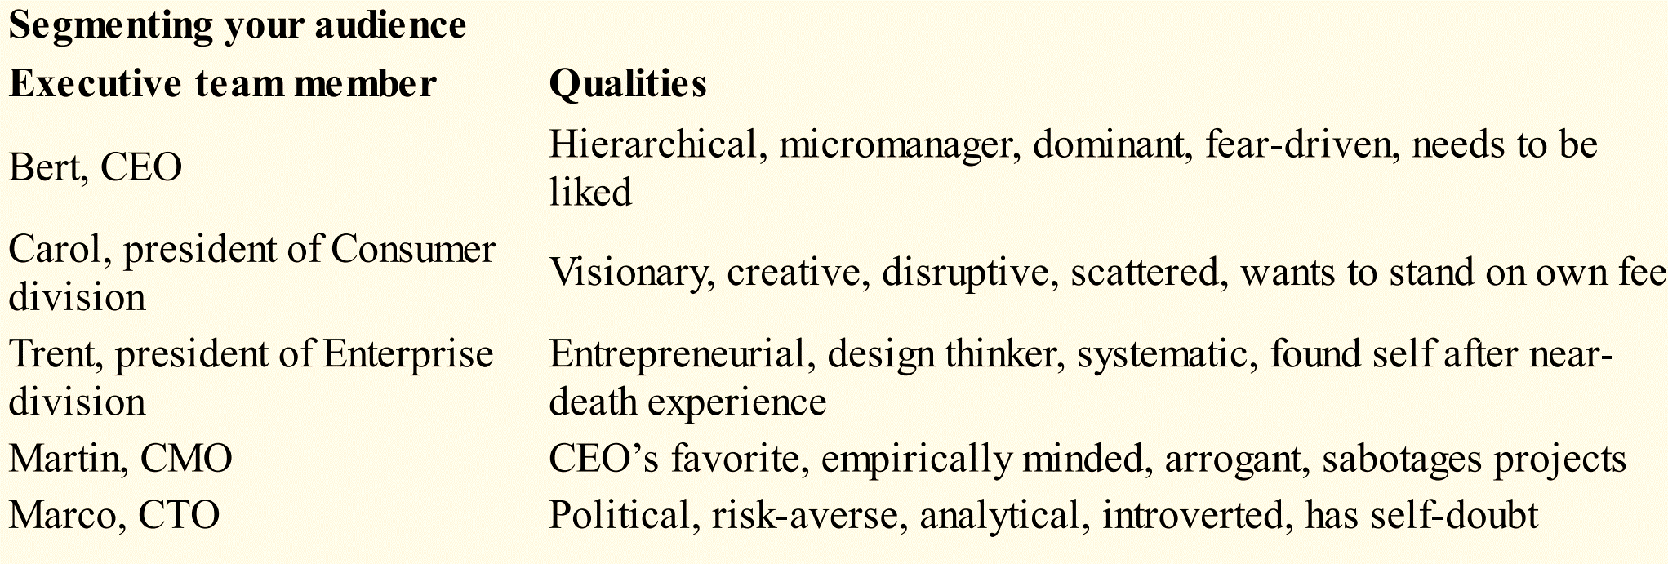
Audience Analysis

Slide 10
Eg: audience analysis
Prospective first time business owners- (non-established)
Low/Non Existent credit score
Expect hand-holding
Understanding of the market place- questionable
Idealistic, hopeful

Slide 11
Audience Attitude | Organization Pattern | Delivery Style | Supporting Material
Friendly/ Low pressure | Any pattern Try new styles | Warm, pleasant, open | Humour Anecdotes Personal exper
Neutral | Structured Pros/cons or problem-solution pattern Time for questions | Controlled Not too showy Confident small gestures Highlight your credential and expertise | Facts Statistics Comparison and contrast Illustrations
Uninterested | Be brief Highlight “what’s in it for them” multiple times | Dynamic Entertaining Move around Lot of gestures | Use humor powerful quotes Startling statistics
Hostile | Use standard patterns (topical,chronological) | Calm and controlled Speak evenly and slowly | Objective data Expert opinions Illustrations

Slide 12
Planning- Anticipating questions/potential problem areas
Write down all the possible questions/concerns/problems/objections.
Involve other concerned individuals
Keep ready all the materials/ supporting evidence handy (separate from presentation)

Slide 13
Planning- Research
Brainstorming
Gather as much supporting material
Primary and Secondary Resources
Wean out the information based on your objective and your audience’s expectation

Slide 14
Eg. Forming a rough draft according to audience needs, possible questions etc
Talk about current business climate
How banks fix interest rates
Types of lenders
Direct online lenders
Commercial banks
Community banks
Crowd-funding
Types business loans available
Working capital loans
Small business line of credit
Equipment loans
Advantages and disadvantages of each type of loan and lender
Lenders look for
a good credit score, cash flow, collateral., time in business, Investors in company, financial statements
Give them an idea of how to draw business plans, financial, market projections
Business plans, profile, financial statements, collateral

Slide 15
Write-
Step 1: Tell them what you are going to tell them.
Step 2: Tell them.
Step 3: Tell them what you have told them.

Slide 16
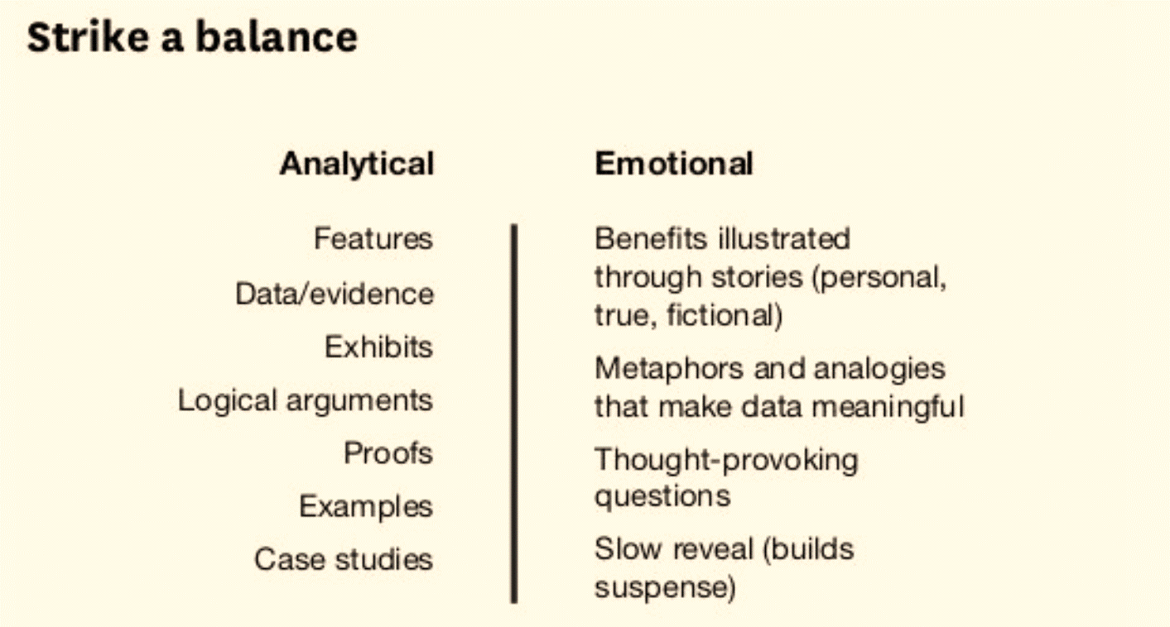
Write: two styles of messaging

Slide 17
Write- Prepare an outline of the talk
Purpose
Major ideas
Sub-points
Logical/thematic order
Add transitions = summary of previous section/ preview of the next
Add a compelling introduction and conclusion
Prepare bibliography
Compelling title

Slide 18
Review goals and progress.
Mechanical design
Goal- 100%
Actual- 80%
Reason for delay: Unanticipated problems with case durability
Software Development
Goal- 50 %
Actual- 100%
Material Sourcing
Goal- 100%
Actual- 45% ( Also materials identified are at 140% of anticipated cost)
Reason for delay: Purchasing is understaffed - Hence no optimal searches for resources conducted
Discuss Schedule Option
Option 1: Reschedule product Launch date
Option 2: Launch on schedule with more expensive materials
Suggest goals for next month
Q&A
To update the executive committee on product development Schedule

Slide 19
Write- Types of organization strategy
Chronology- eg. History; order of appearance; steps
Geography- eg. Diversity in workforce according to region
Topic wise- eg. When discussing different issues at an annual meeting
Pros and cons- eg. when comparing e-commerce vs retail etc
Journalistic style (who, what, when, why, how)- eg. analysis; introduction
Importance- eg. 3 reasons why….
Problem- Solution- eg. Solution to declining profit; delayed project
Best case/ worse case scenario- eg. Company merger (shares/ profitablity)

Slide 20
Eg: Forming a rough draft according to audience needs, possible questions etc
Talk about current business climate
How banks fix interest rates
Types of lenders
Direct online lenders
Commercial banks
Community banks
Crowd-funding
Types business loans available (If there is time, questions may come)
Working capital loans
Small business line of credit
Equipment loans
Advantages and disadvantages of each type of loan and lender (If there is time; questions may come)
Lenders look for
a good credit score, cash flow, collateral., time in business, Investors in company, financial statements
Give them an idea of how to draw business plans, financial, market projections
Business plans, profile, financial statements, collateral

Slide 21
Eg: Final outline: Narrowing down to just 3 key important points
Experience,
Demonstrate experience,
Include resume in your proposal
Key players, management and investors
Preparation-
market knowledge
research on the market and industry conducted
Projection-
projection of potential sale, cash flow and equity (atleast for first year)
contingency plans

Slide 22
Write- Intro or the hook (A-B-C-D)
Your intro should have one or more of the following
Hook Audience Attention- Startling facts/ statistics; Anecdotes; Questions; humour; Statements of empathy; Alerts; Promises
Highlight the Benefits
Establish your Credibility
Lay out the Direction (outline) of the talk

Slide 23
A suitable hook
An anecdote or story that relates to the audience.
When X wanted to start his business, it was Y who helped them out. Now imagine a world without product X.
Question
How many of you here have a revolutionary idea, a brilliant business proposal but the only thing that is stopping you is money
Scare tactics
We all know that in last few years there slowing in global market growth. Banks not keen to invest only with established businesses. Last year approval rates dropped to just 23%
Start with a Choice.
I have some good news and some bad news what to do you want first? the bad news, the big bank approval rate has dropped to just 23.1 percent. This means that less than a quarter of businesses applying for a loan will receive one. But the good news is that institutional lenders’ loan approval rates have matched an all-time high at 62.8 percent.

Slide 24
Benefit:
If you concentrate you will get inside information- totally exclusive- on how to bag that capital beating out other applicants with better credit scores. If you do get these three things right- just 3 things- you might as well start looking for an office space right away, because your loan is as good as approved!

Slide 25
FEATURE VS BENEFIT
Feature | Benefit
Next day delivery | No more going to store/waiting in line
Pockets in the front | A place for your key, keeping your hands warm
Sun banning- Roof sheathing | Keep cool in summer; save electricity
4g | Load pages faster; find home when lost
Swiggy | Your favourite restaurant delivered home

Slide 26
Body-the line
Clear vivid ideas/Language
Proper structure as developed in the outline using set principles
Proper transitions
The next segment of my talk presents three reasons for. . . . Let me review with you the major problems I have just discussed.
Thus far we have talked solely about . . . ; now let’s move to. . . .
Illustrations- analogy; metaphors; visual data;
Establish relationship between your subject and familiar ideas
Examples of analogy:
Downsizing is comparable to an overweight person’s regimen of dieting and exercising
One typical meal at a fast food restaurant contains all the calories you need for an entire day.
Our critics used our report like a drunk uses a lamppost—for support rather than illumination.
I always worried about my pets while I was away. That’s when I decided to start a pet hotel

Slide 27
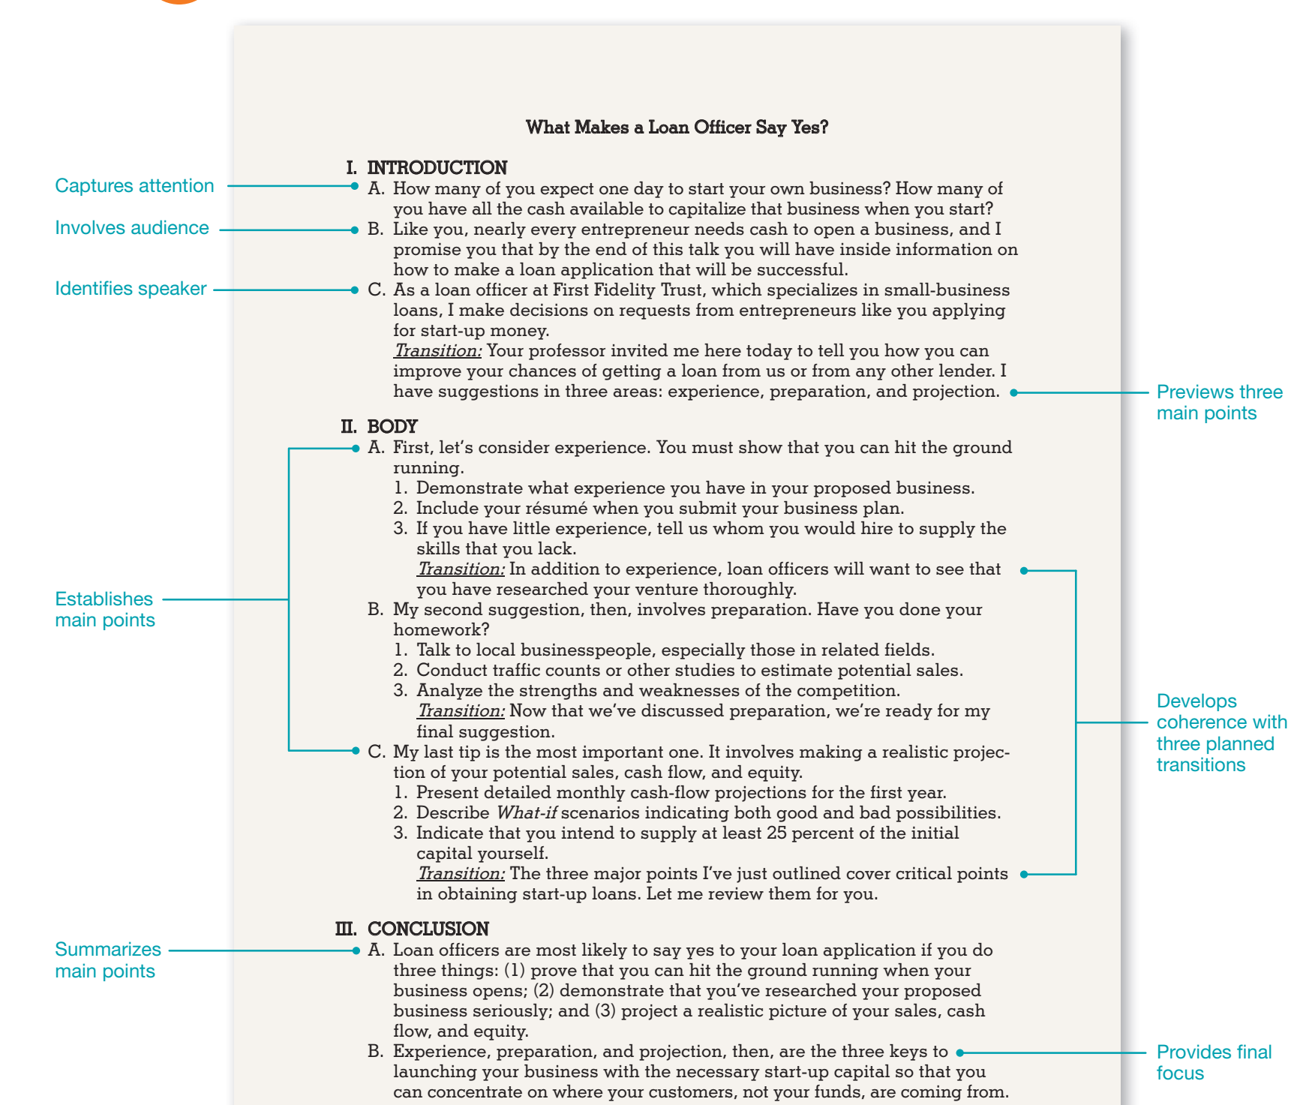

Slide 28
Language that persuade people
Exclusivity
Safety/Risk-aversion
Community
Egocentricity
Power/Status
Instant Solution
-est mentality
Saving time and money
Secrecy
Scarcity
Bargain
Guarantee/Predictability
Privacy

Slide 29
Power words
You
New/Improved/LATEST/ultimate/ground breaking/trail blazing
Free
Discount/Bargain/Save
Sensational/remarkable/Amazing/awesome/extraordinary
Miracle/magic
Instantly/Quick
Secret
Now/Immediately

Slide 30
Discover/increase/help
Because
Hurry
More/Extra
Join/ Become a member/ Come along
Limited offer/Supplies running out/Only for next 2 hours
Members only/ Ask for an invitation/Become an insider/ Be one of the few/ Get it before everybody else
Backed/ Best-selling/ Cancel Anytime/ Certified /Endorsed/ No Questions Asked

Slide 31
Write- Closing or the sinker
Restate the main points.
Establish consensus
Clarity on expected actions
Poor conclusion: Well, I guess that’s about all I have to say. Thanks for your time. Improved: In bringing my presentation to a close, I will restate my major purpose. . . . Improved: In summary, my major purpose has been to. . . . Improved: In conclusion, let me review my three major points.
Let me highlight the key take away
l

Slide 32
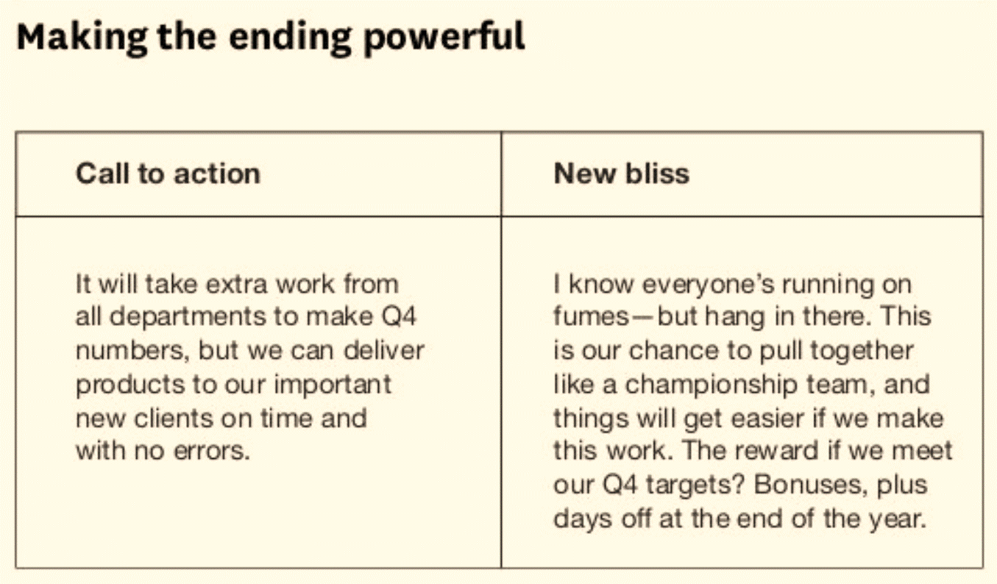

Slide 33
Writing- things to consider further
Allotted Time– Ideally 20 minutes
Elevator pitch
Presentations for different durations

Slide 34
Complete- Practise
Can you present material without reading the slides
Time track your presentation
Carry notes
Prepare for early/late finish time
Equipment checks
Charge laptop/ check software
Have presentation in multiple formats/ platform
Be familiar with equipment
Dress professionally
Reach before time at the venue
Check the room

Slide 35
Complete- Mechanics of Speaking
Drink water, use the facilities beforehand
Breathe!
Stand tall
Smile
Eye contact (Find a few people to look at when tensed)
Speak Slowly
Stress on important points for emphasis
Speak in the right tone and pitch
Open body gestures
Move Around
Be in Charge!
Show enthusiasm
Skip Apologies!!

Slide 36
Complete- Handling Questions
Do specify when you would like to handle questions
Establish ground rules!
Understand that questions are the best feedback.
Treat them as a chance to emphasize your ideas
Pay attention to the question- Don’t assume
Pay attention to the non-verbal cues
Rephrase the question
Do not shy away from difficult questions
Treat every question as equally important
Make a commitment to answer later in case you are unsure
Do not lose temper

Slide 37
Assignment- 10 marks
See a TED talk on technology
Analyse it on the basis of what we discussed in this PPT
Prepare the outline of the talk
Type of presentation is it
analyze the structure
Type of structuring principle
Main points
Supporting data/arguments for each point
How effective was the hook and sinker
Metaphors, analogies, demonstration
complex data into easily understandable language
Mechanics of speaking
Audience analysis/involvement

